Slide 1

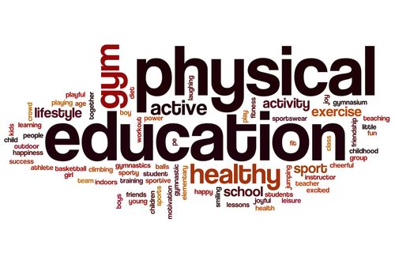

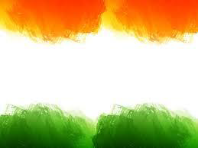
SHRI GURU GOBIND SINGH JI GOVT. COLLEGE,
PAONTA SAHIB, SIRMOUR (H.P)

Slide 2

B.A. 2nd YEAR
COURSE NAME: SPORTS PSYCHOLOGY
COURSE CODE: PED202TH

Slide 3
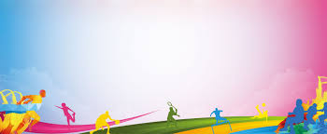
PSYCHOLOGY FACTORS, GROWTH AND DEVELOPMENT

Slide 4
TOPICS TO BE COVERED
FACTORS AFFECTING SPORTS PERFORMANCE

Slide 5
FACTORS AFFECTING SPORTS PERFORMANCE
The psychological factors of sports and exercise that most affect performance are: self-confidence, motivation, emotional control, and concentration.

Slide 6
MOTIVATION:
This is important for any area you want to optimize your performance in. It is especially important in sports.
Think about athletes who experience constant ups-and-downs, wins and losses.
In their case, intrinsic motivation and love for what they do is usually what helps them recover after a bad pass, a terrible throw, or a much lower score than they were expecting.

Slide 7
CONCENTRATION:
Athletes also need to have the ability to concentrate intensely.
All actions, even the most simple or intuitive ones, require concentration.
A poorly executed move can result in a loss or an injury. It can ruin months of preparation.
That’s why even an athlete with mediocre training is not usually distracted.

Slide 8
Emotional control:
Doing mental training exercises that help you control your emotions and doubts can make the difference between success and failure. When poor emotional control affects an athlete’s performance, it is usually because she let her emotions affect her concentration.
Self-confidence:
Lastly, confidence in your ability to successfully complete a task is an essential condition for victory

Slide 9
Attention control:
Both internal and external attention. Internal attention is when an athlete focuses on things happening in her own body (thoughts, internal dialogue, feelings, and movements). External attention is when an athlete focuses on things outside of her own body.
Setting goals:
This helps athletes get an overall vision of the work they have to do. They can also visualize what they have to achieve to get to their final goals.

Slide 10
Self-instructions:
These are messages or short affirmations that we tell ourselves to help with motivation or concentration. It’s important to use rational, positive, logical, and realistic affirmations.
Relaxation:
A relaxation technique is any method, procedure, or activity that helps reduce physical and/or mental tension. It is meant to lower stress and anxiety and replace them with peace.

Slide 11
Mental representation:
Mental representations are symbolic ways of reproducing reality. Visualization is extremely powerful for athletes and non-athletes alike.

Slide 12


